Slide 1
Context boundary effects and memory: the impact of attention, aging, and focal brain lesions
Michael R. Dulas, Ph.D.
Cog BB
Nov 3,
2017

Slide 2
Episodic Memory = Memory for Time+Place
Notes:
While somewhat reductionist, most episodic memories are memories for something at occurred at a particular time and place. That is, we, and by extension our memories, live in a spatiotemporally defined world.

Slide 3
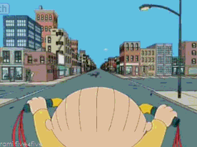
Time and Space Are Continuous Measures
Notes:
Yet time and space are both continuous measures. Time plods ceaselessly forward, whether measured in hours, minutes, seconds, or smaller increments. And space sprawls out around us on continuous x, y, z planes. Take this video for example. This child is riding his big wheel at a continuous speed and thus covering a continuous amount of space over time. Yet it is likely that your perception, and subsequently your memory, of this video will not be continuous in nature.

Slide 4


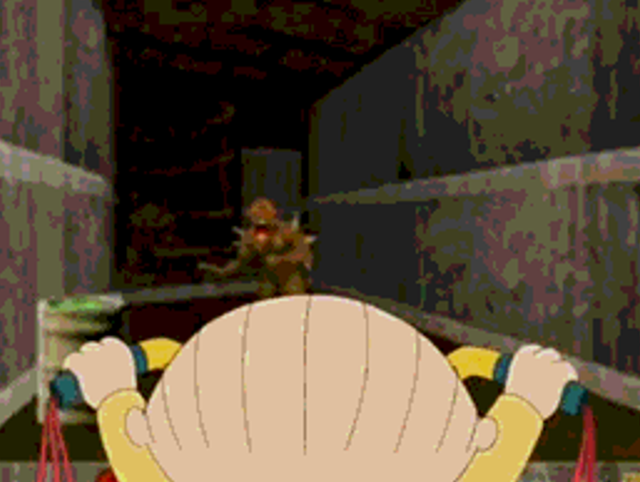

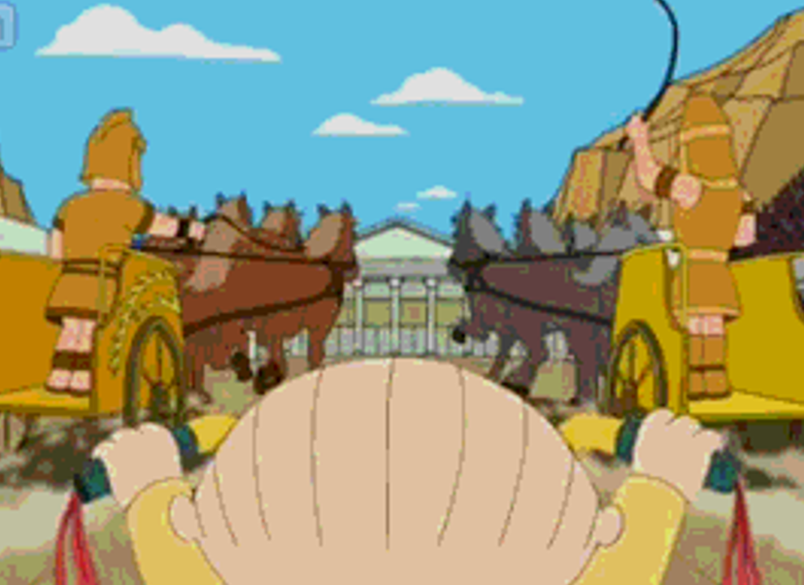


Rather we perceive and remember distinct slices or segments of the world
Notes:
Indeed, you likely can easily remember some of the different scenes the boy rode through, but you may not even remember the order in which these contextual episodes occurred.

Slide 5
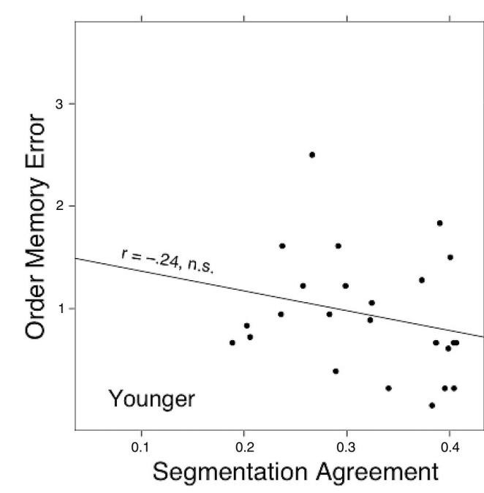
Context as an organizing principle
We automatically make sense of the world by segmenting, or parsing activities into separable events (Kurby and Zacks, 2008 for review)
Segmentation usually occurs when a large perceptual or conceptual change occurs – a Context Boundary (CB)
The ability to normatively segment ongoing information has been correlated with subsequent memory, particularly in older adults (Zacks, Speer, Vettel, & Jacoby, 2006)
Modified from Zacks et al., 2006
Notes:
Results showed that items sharing the same context were much more likely to receive a close or very close endorsement compared to across context pairs, again despite actually being equidistant at study.
This suggests that participants are somehow integrating information within context, as well as using context boundaries to discriminate across contexts.

Slide 6
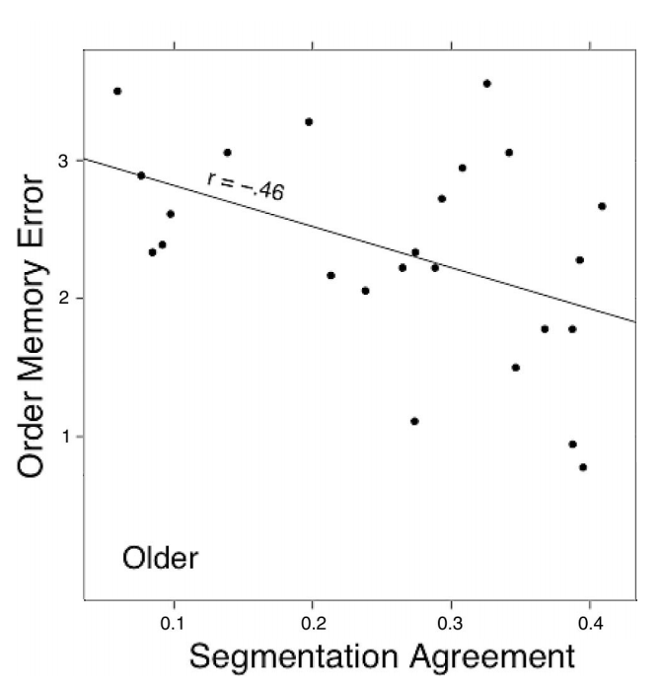
Context as an organizing principle
We automatically make sense of the world by segmenting, or parsing activities into separable events (Kurby and Zacks, 2008 for review)
Segmentation usually occurs when a large perceptual or conceptual change occurs – a Context Boundary (CB)
The ability to normatively segment ongoing information has been correlated with subsequent memory, particularly in older adults (Zacks, Speer, Vettel, & Jacoby, 2006)
Modified from Zacks et al., 2006
Notes:
Results showed that items sharing the same context were much more likely to receive a close or very close endorsement compared to across context pairs, again despite actually being equidistant at study.
This suggests that participants are somehow integrating information within context, as well as using context boundaries to discriminate across contexts.

Slide 7
Context as an organizing principle
We automatically make sense of the world by segmenting, or parsing activities into separable events (Kurby and Zacks, 2008 for review)
Segmentation usually occurs when a large perceptual or conceptual change occurs – a Context Boundary (CB)
The ability to normatively segment ongoing information has been correlated with subsequent memory, particularly in older adults (Zacks, Speer, Vettel, & Jacoby, 2006)
Context boundaries can also bias memory for temporal distance between items (Ezzyat & Davachi, 2011, 2014; Dubrow & Davachi, 2013, 2014)
Notes:
Results showed that items sharing the same context were much more likely to receive a close or very close endorsement compared to across context pairs, again despite actually being equidistant at study.
This suggests that participants are somehow integrating information within context, as well as using context boundaries to discriminate across contexts.

Slide 8
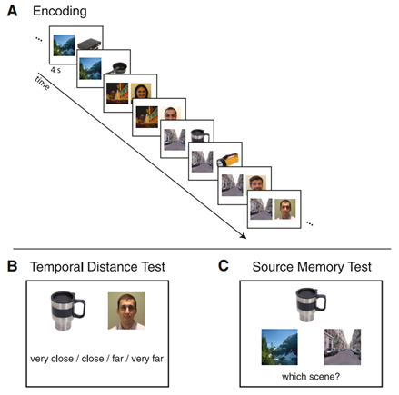
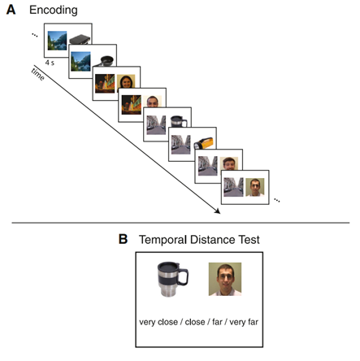
Context as an organizing principle
We automatically make sense of the world by segmenting, or parsing activities into separable events (Kurby and Zacks, 2008 for review)
Segmentation usually occurs when a large perceptual or conceptual change occurs – a Context Boundary (CB)
The ability to normatively segment ongoing information has been correlated with subsequent memory, particularly in older adults (Zacks, Speer, Vettel, & Jacoby, 2006)
Context boundaries can also bias memory for temporal distance between items (Ezzyat & Davachi, 2011, 2014; Dubrow & Davachi, 2013, 2014)
Across
Context
Same
Context
From Ezzyat & Davachi, 2014
Notes:
Results showed that items sharing the same context were much more likely to receive a close or very close endorsement compared to across context pairs, again despite actually being equidistant at study.
This suggests that participants are somehow integrating information within context, as well as using context boundaries to discriminate across contexts.

Slide 9
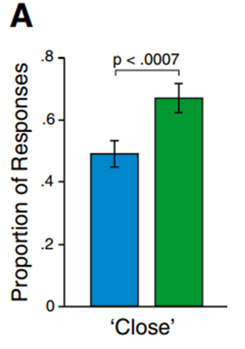
Context as an organizing principle
We automatically make sense of the world by segmenting, or parsing activities into separable events (Kurby and Zacks, 2008 for review)
Segmentation usually occurs when a large perceptual or conceptual change occurs – a Context Boundary (CB)
The ability to normatively segment ongoing information has been correlated with subsequent memory, particularly in older adults (Zacks, Speer, Vettel, & Jacoby, 2006)
Context boundaries can also bias memory for temporal distance between items (Ezzyat & Davachi, 2011, 2014; Dubrow & Davachi, 2013, 2014)
Across
Context
Across
Context
Same
Context
Same
Context
Rated as Close or Very Close
From Ezzyat & Davachi, 2014
From Ezzyat & Davachi, 2014
Notes:
Results showed that items sharing the same context were much more likely to receive a close or very close endorsement compared to across context pairs, again despite actually being equidistant at study.
This suggests that participants are somehow integrating information within context, as well as using context boundaries to discriminate across contexts.

Slide 10
But memory involves time and space…
To date, little known about whether context boundaries similarly impact temporal and spatial memory
Further, unclear if both are simultaneously impacted by a shift in context or whether one must be directly attending to that domain
Automatically perceiving a context boundary does not mean its effects on memory are also automatic

Slide 11
Present Questions
Experiment 1
Do context boundaries similarly impact both spatial and temporal order memory within the same experiment?
Are context boundary effects on memory automatic, or do participants need to be actively attending to the critical domain?
Notes:
Several questions have arisen out of this previous work. One is whether all forms of context boundaries have a similar impact on memory. Namely, are these effect similar for both spatial and temporal order memory.
Further, while it’s been suggested that the perception of context boundaries may be automatic, it is unclear whether their impact on memory is also automatic, or whether active attention is necessary to bias/organize memory represetnations.

Slide 12
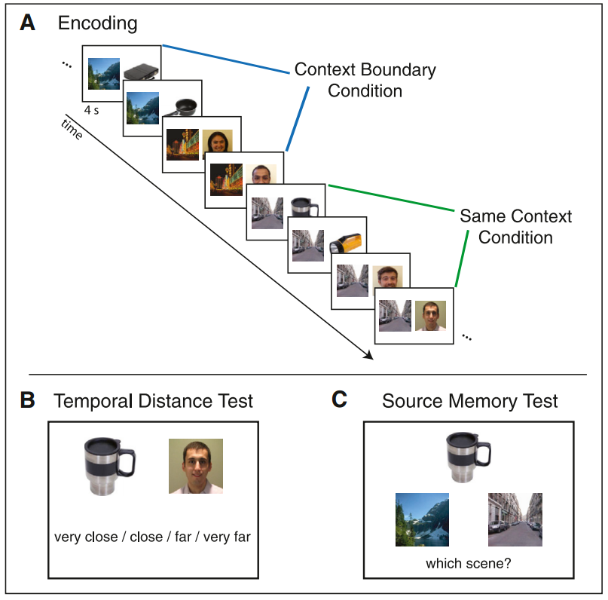
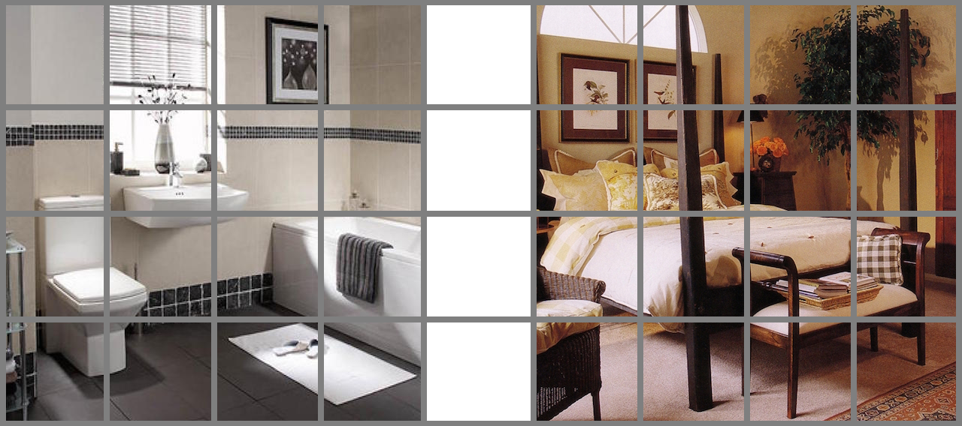
Spatiotemporal Context Task
From Ezzyat & Davachi, 2014
Notes:
To test these questions, we developed a task inspired by the Ezzyat and Davachi work. However, in our spatiotemporal context task, the scenes are present on the screen throughout the block, and have a spatial grid overlaid on them.

Slide 13





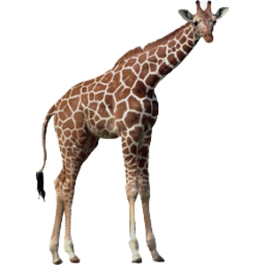
Spatiotemporal Context Task
Study Phase: Objects on screen for 3500 ms each. 16 per block.
Asked to rate how easy/hard it is to imagine each object in its scene.
Notes:
CLICK ONLY FIRST ONE THEN DESCRIBE
MENTION WHEN ON
Objects then show up one at a time in different locations on the grid for 3500 ms each. To keep participants attending to the task, they were asked to determine how easy or hard it was to imagine each object in its context. As you can see, after some number of trials, there would be a context boundary, wherein objects would start appearing in the other context.

Slide 14
Distance Judgment – Temporal Block
How far apart were these objects in:
TIME
1 = Very Close
2 = Close
3 = Far
4 = Very Far
Notes:
Afterwards, participants were given a distance judgment task. For some blocks, they were asked to judge the temporal distance of the pairs.

Slide 15
Distance Judgment – Spatial Block
How far apart were these objects in:
SPACE
1 = Very Close
2 = Close
3 = Far
4 = Very Far
Notes:
In other blocks, they were asked to judge the spatial distance of the pairs, i.e. number of cells apart on the grid.

Slide 16
Example Set of Locations
Notes:
So for a given block, we might get a set of studied locations like this:

Slide 17
Example Set of Locations
Numbers represent the order
in which they appeared
Notes:
Where the numbers represent the order in which they appeared. Pairs selected on spatial distance were always horizontal from each other and consisted of the following conditions:

Slide 18
Example Set of Locations & Spatially Defined Pairs
Two sets of 3-away Within Context Pairs
Notes:
Pairs could be 3 cells away, within the same context…

Slide 19
Example Set of Locations & Spatially Defined Pairs
Two sets of 3-away Across Context Pairs
Notes:
3 cells away but across the context boundary.

Slide 20
Example Set of Locations & Spatially Defined Pairs
Two sets of Adjacent Pairs
Notes:
Adjacent to each other.

Slide 21
Example Set of Locations & Spatially Defined Pairs
Two sets of Far Away Pairs
Notes:
Or far away from each other.
Untold to the participant, all of the selected pairs for 1 and 3 aways were horizontal from each other to prevent issues with comparing diagonals. To keep participants from catching on to this, the far away pairs did not necessarily have to be on the same row.

Slide 22
Example Set of Locations & Spatially Defined Pairs
Notes:
The nice thing about this design is that the exact same set of locations and orders can be reused for a temporal block, with different pairs selected based on temporal distance.

Slide 23
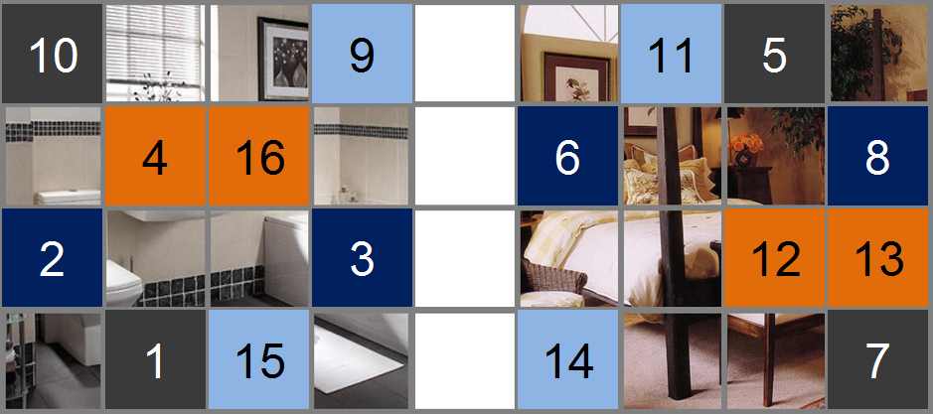
Example Set of Locations & Temporally Defined Pairs
Can also use same configuration in Temporal Blocks, just selecting different pairs (based on distance in order instead)

Slide 24
Example Set of Locations & Temporally Defined Pairs
Two sets of 3-away Within Context Pairs

Slide 25
Example Set of Locations & Temporally Defined Pairs
Two sets of 3-away Across Context Pairs

Slide 26
Example Set of Locations & Temporally Defined Pairs
Two Adjacent Pairs:
One Within Context, One Across

Slide 27
Example Set of Locations & Temporally Defined Pairs
Two Far Away Pairs:
One Within Context, One Across

Slide 28
Example Set of Locations & Temporally Defined Pairs
Across blocks, counterbalanced so that all locations used equally, all locations part of different distance pairs, and there was no correlation between actual Spatial and Temporal distance of Pairs

Slide 29
Experiment 1
23 Young Adults
48 total blocks
16 objects each
~1 minute per study phase
Half of the blocks test Space; half test Time
Attention manipulation
Directed: For half of the blocks, told prior to study which domain would be tested
Undirected: For the other half, not told until test phase which domain would be tested
Space and Time blocks pseudorandomly intermixed to prevent being able to anticipate the test phase domain
Notes:
Experiment 1 consisted of:

Slide 30
Experiment 1 – Spatial Results
Notes:
For the results I’ll be showing you, I’ve taken the average rating from 1 (close) to 4 (far) for each of the 4 pair conditions.

Slide 31
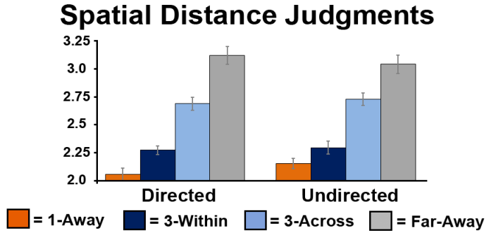
Experiment 1 – Spatial Results
ANOVA: Main Effect Trial Type (p < 0.001)
All trial types are significantly different t’s > 2.40, p’s < 0.03
Context boundary effect, spatial memory
*
*
*
Avg Distance Rating
(1- 4 Scale)
*
*
Notes:
As you can see, participants were able to discriminate the various distance from each other. More importantly for our questions, participants showed a robust context boundary effect.

Slide 32
Experiment 1 – Spatial Results
ANOVA: Main Effect Trial Type (p < 0.001)
All trial types are significantly different t’s > 2.40, p’s < 0.03
Context boundary effect, spatial memory
Nearly identical results for Undirected blocks
*
*
*
*
Avg Distance Rating
(1- 4 Scale)
*
*
Notes:
Results were very similar for the undirected condition, initially suggesting attention during encoding was not necessary…

Slide 33
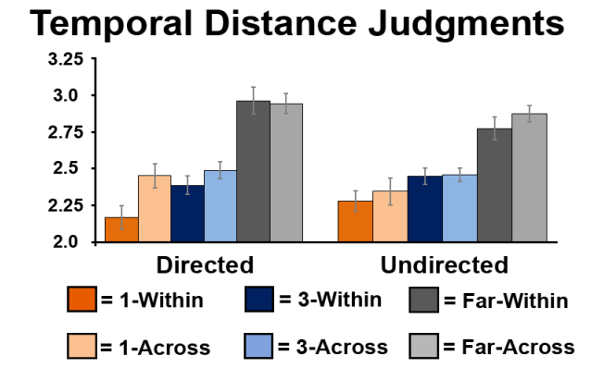
Experiment 1 – Temporal Results
For Time blocks, boundary effects can be investigated at various distances
1 within vs. across
3 within vs. across
Far w/in vs. across
ANOVA then includes Context (Within, Across) and Distance (1, 3, Far)
Notes:
For the temporal blocks, participants again discriminated the different distances, and still showed a context boundary effect.

Slide 34
Experiment 1 – Temporal Results
ANOVA: Main Effect Distance (p < 0.001)
All distances are significantly different t’s > 2.63, p’s < 0.016
Temporal context boundary effects:
1-away [p = 0.004]*
3-away [p = 0.01]*
Far [p = 0.24] ns
Linear decrease in boundary effect w/ distance [p = 0.01]
*
*
Notes:
For the temporal blocks, participants again discriminated the different distances, and still showed a context boundary effect.

Slide 35
Experiment 1 – Temporal Results
In the Undirected Condition, still a Main Effect of Distance (p < 0.001)
But there are no context boundary effects at any distance [p’s > 0.24]
Overall average for each distance similar to the directed condition
*
*
Notes:
For the temporal blocks, participants again discriminated the different distances, and still showed a context boundary effect.

Slide 36
Experiment 1 Summary
Questions of interest:
Do context boundaries similarly impact both spatial and temporal order memory within the same experiment?
Yes!
Are context boundary effects on memory automatic, or do participants need to be actively attending to the critical domain?
Not always automatic…
Likely that because contexts were spatially defined, participants attended to space when undirected
But still shows that perceiving a context boundary does not necessarily produce effects on all memory domains
Notes:
So to answer my research questions….

Slide 37
Experiment 2
Questions of interest:
Do the effects of context boundaries on memory relate to better subsequent memory?
Modified from Zacks et al., 2006
Notes:
Experiment 2 then asked a different set of questions. Given the role of the PFC and the hippocampus, both regions that can show age-related decline, we then wanted to know whether context boundary effects were impacted by healthy aging. Further, we aimed to use patients with either hippocampal or vmPFC lesions to disentangle the distinct contributions of these regions to the contextual organization in memory.

Slide 38
Experiment 2
Questions of interest:
Do the effects of context boundaries on memory relate to better subsequent memory?
Are there age-related differences in context boundary effects?
Same setup but added an item-context memory phase
Looking at correlation between individual differences in context boundary effect and subsequent memory
Focusing on Spatial Memory variant (can talk about temporal later if interested after)
Notes:
Experiment 2 then asked a different set of questions. Given the role of the PFC and the hippocampus, both regions that can show age-related decline, we then wanted to know whether context boundary effects were impacted by healthy aging. Further, we aimed to use patients with either hippocampal or vmPFC lesions to disentangle the distinct contributions of these regions to the contextual organization in memory.

Slide 39



Item-Context Memory Task
Where?
When?
First Second
Half Half

Slide 40
Experiment 2
26 YA’s (18-33; 10 males, 15.3 years edu)
26 OA’s (62-81; 10 males, 16.1 years edu)
Matched on:
Gender (exact)
Years of education (p = 0.19)
All participants within age-related norms on a battery of neuropsychological tests
MMSE, Trail Making, Digit Span, Digit Symbol, Word List
Notes:
Experiment 2 then asked a different set of questions. Given the role of the PFC and the hippocampus, both regions that can show age-related decline, we then wanted to know whether context boundary effects were impacted by healthy aging. Further, we aimed to use patients with either hippocampal or vmPFC lesions to disentangle the distinct contributions of these regions to the contextual organization in memory.

Slide 41
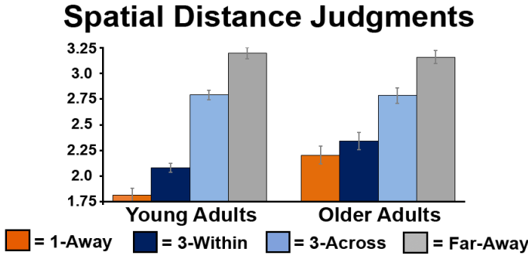
Experiment 2 – Spatial Results
Both groups show significant context boundary effects (p’s < 0.001]
However, the effect was significantly smaller for older adults [p = 0.01]
Driven by older adults giving higher ratings for 1-away and 3-within pairs [p’s < 0.01]
*
*
Avg Distance Rating
(1- 4 Scale)
*
Notes:
As you can see, participants were able to discriminate the various distance from each other. More importantly for our questions, participants showed a robust context boundary effect.

Slide 42
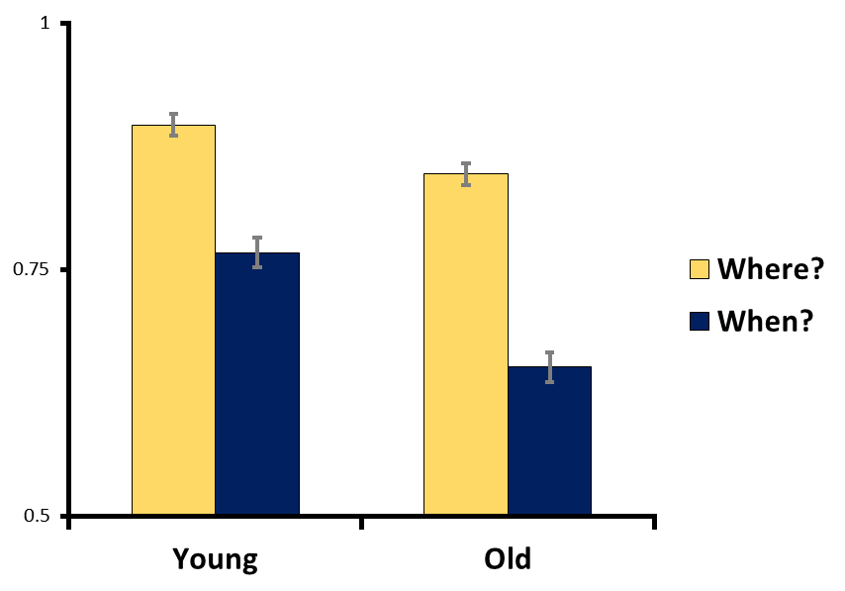
Experiment 2 – Item-Context Results
*
Both groups showed better memory for Where? than When? [p’s < 0.001]
Older adults showed poorer memory for both contexts [p’s < 0.004]
Though more pronounced for “When?”
*
*
Proportion of Hits
Notes:
As you can see, participants were able to discriminate the various distance from each other. More importantly for our questions, participants showed a robust context boundary effect.

Slide 43
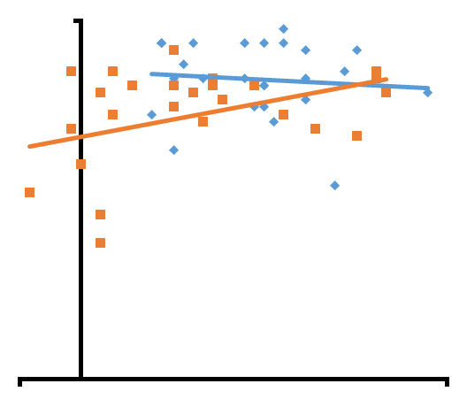
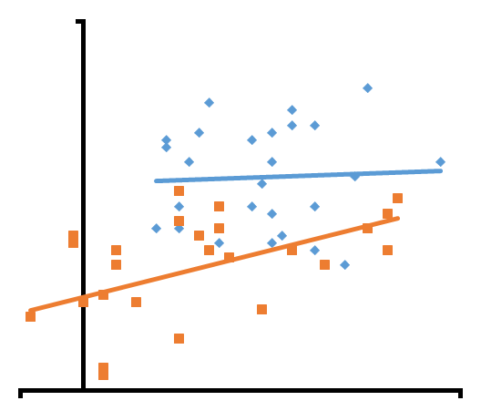
Experiment 2 – Correlation Results
“Where?” Context
“When?” Context
1.0
1.0
Item-Context Accuracy
Item-Context Accuracy
YA’s: r = -0.08, p = 0.69
OA’s: r = 0.41, p = 0.04*
YA’s: r = 0.07, p = 0.75
OA’s: r = 0.49, p = 0.01*
0.5
0.5
-0.25
1.25
-0.25
1.25
Context Boundary Effect
Context Boundary Effect
Notes:
For both where and when, spatial context boundary effects correlated with subsequent item context memory

Slide 44
Experiment 2 Summary
Do the effects of context boundaries on memory relate to better subsequent memory?
Yes! At least in Older Adults
Likely an issue of less variance in young adults
Are there age-related differences in context boundary effects?
Yes, older adults show reduced context boundary effects
Driven by higher ratings of within-context pairs and correlated with poorer item-context memory
May suggest older adults less likely/able to integrate information within context compared to young adults

Slide 45
Discussion of Experiments 1 & 2
Context boundaries may serve to facilitate the organization of information in service of future memory
Facilitates the integration of within-context information and the discrimination between across-context information
However, these organizational effects are not necessarily automatic and require online processing
Given that this task was relatively short (16 items over 1 minute with immediate test), suggests the organizational effects are occurring online, during information acquisition
Does not rule out that these effects become more pronounced during consolidation
Age-related changes in context boundary effects are related to poorer memory for item-context associations
Future work necessary to determine if this is particularly tied poorer within-context integration

Slide 46
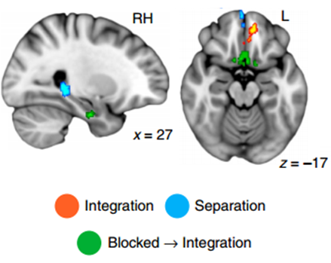
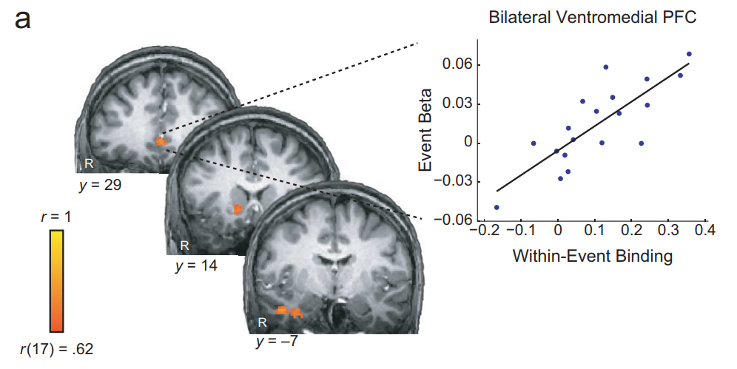
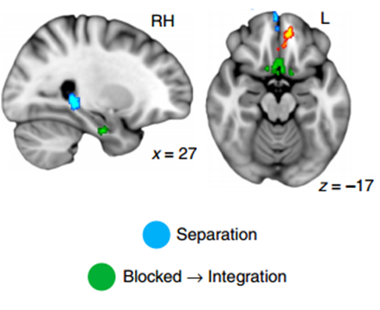
Integration & Discrimination
Evidence that the hippocampus, as well as the ventromedial prefrontal cortex (vmPFC), may support integration within and discrimination across episodes/contexts (e.g. Swallow et al., 2011; Ezzyat & Davachi, 2011; 2014; Davachi & DuBrow, 2015; Schlichting, Mumford, & Preston., 2015)
Hippocampus
vmPFC
Ezzyat & Davachi, 2011
Figure modified from
Schlichting, Mumford, & Preston, 2015
Notes:
(boundary nextsentence recall minus preboundary next-sentence recall; this measure is hereafter referred to as within-event binding

Slide 47
Integration & Discrimination
Evidence that the hippocampus, as well as the ventromedial prefrontal cortex (vmPFC), may support integration within and discrimination across episodes/contexts (e.g. Swallow et al., 2011; Ezzyat & Davachi, 2011; 2014; Davachi & DuBrow, 2015; Schlichting, Mumford, & Preston., 2015)
Unclear what the distinct contributions of these regions to context boundaries are
Can lesion studies differentiate the contributions of the vmPFC and the hippocampus to context boundary effects in memory?
Notes:
(boundary nextsentence recall minus preboundary next-sentence recall; this measure is hereafter referred to as within-event binding

Slide 48
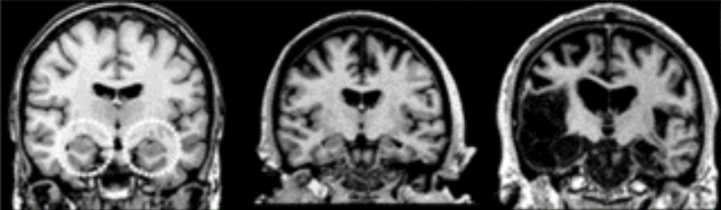
Experiment 3
Participants
3 bilateral hippocampal lesion patients (2M 1F; ages 53-64)
Healthy Control 1846 1951
Notes:
Klooster scans or creativity for better scans

Slide 49
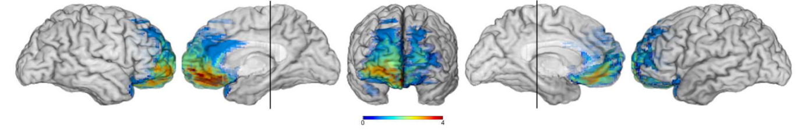
Experiment 3
Participants
3 bilateral hippocampal lesion patients (2M 1F; ages 53-64)
3 vmPFC lesion patients (1M 2F; ages 63-77)
From Kurczek et al., 2013

Slide 50
Experiment 3
Participants
3 bilateral hippocampal lesion patients (2M 1F; ages 53-64)
3 vmPFC lesion patients (1M 2F; ages 63-77)
12 healthy older adult comparison participants
2 matched for age, education, and gender with each of the patients
Blocks reduced to 8 items, 30 seconds at study phase

Slide 51
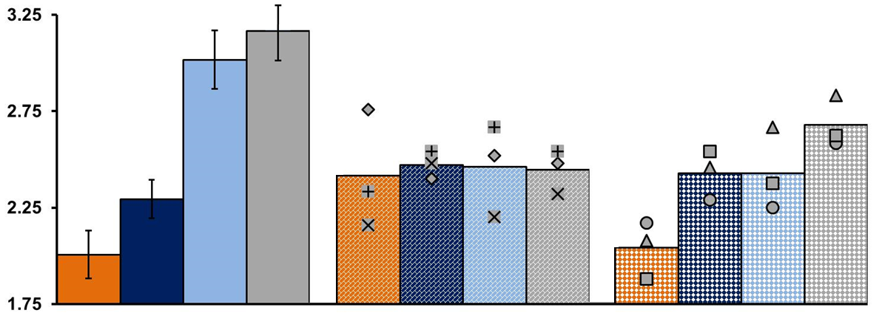
Experiment 3 – Spatial Distance Ratings
Older adults show robust CB effects
Avg Distance Rating (1- 4 Scale)
Healthy Older Adults
= Adjacent = 3-Within = 3-Across = Far Away
Notes:
As you can see, older adults showed quite robust context boundary effects. I will note we do have another study where older adults do the same version as young adults, and show similar effects compared to the young.

Slide 52
Experiment 3 – Spatial Distance Ratings
HC patients at chance for all distances
Avg Distance Rating (1- 4 Scale)
Healthy Older Adults
Hippocampal Patients
= Adjacent = 3-Within = 3-Across = Far Away

Slide 53
Experiment 3 – Spatial Distance Ratings
vmPFC patients do not show CB effect
Avg Distance Rating (1- 4 Scale)
Healthy Older Adults
Hippocampal Patients
vmPFC Patients
= Adjacent = 3-Within = 3-Across = Far Away

Slide 54
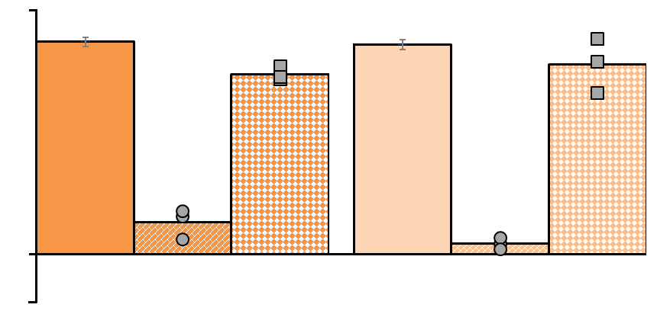
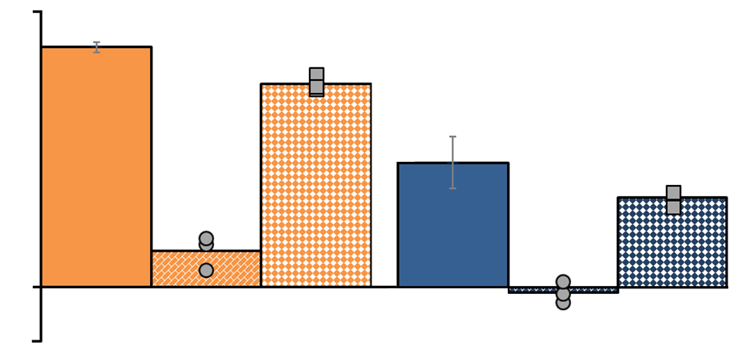
Experiment 3 – Item-Context Results
HC, but not vmPFC, patients impaired
1.0
Item-Context Memory Results
Item-Context Accuracy
0.4
Where? Context
When? Context
= Healthy Older Adults = HC Patients = vmPFC Patients

Slide 55
Experiment 3 Summary
Can lesion studies differentiate the contributions of vmPFC and the hippocampus to context boundary effects in memory?
HC lesions impacted ratings for all distances
vmPFC lesions only impact the context boundary effect
No impact on item-context memory, at least in this relatively easy task
Likely there would be an impact at larger set sizes or longer delays

Slide 56
Conclusions
In healthy participants, contexts serve to guide and bias the integration vs. discrimination of information in memory
This biasing effect of context likely occurs online during encoding, as effects were evident even for only 8 items over 30 seconds
While the hippocampus is necessary for all facets of memory, the vmPFC is critical for using context to organize memory

Slide 57


Acknowledgements & Thanks!
The Memory Systems Lab
Our collaborator Melissa Duff
Our funding: NIH/NIMH grant R01-MH062500
And thank you for your attention!

Slide 58
Boundary between actual talk and bonus slides

Slide 59
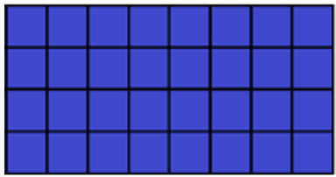
Experiment 1A – One Context Spatial task

Slide 60
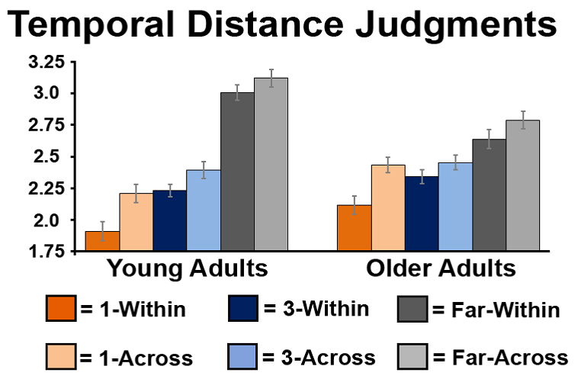
Experiment 2 – Temporal Task YA & OA

Slide 61
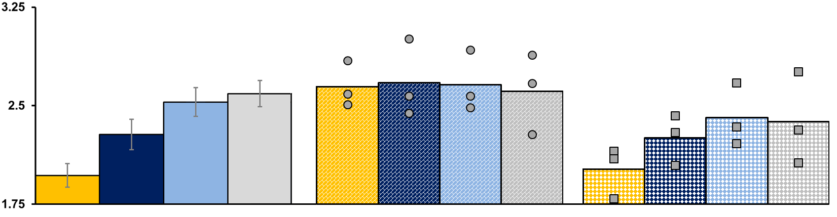
Experiment 3 – Temporal Distance Ratings
vmPFC also impaired at temporal distance
Avg Distance Rating (1- 4 Scale)
Healthy Older Adults
Hippocampal Patients
vmPFC Patients
= Adjacent = 3-Within = 3-Across = Far Away

Slide 62
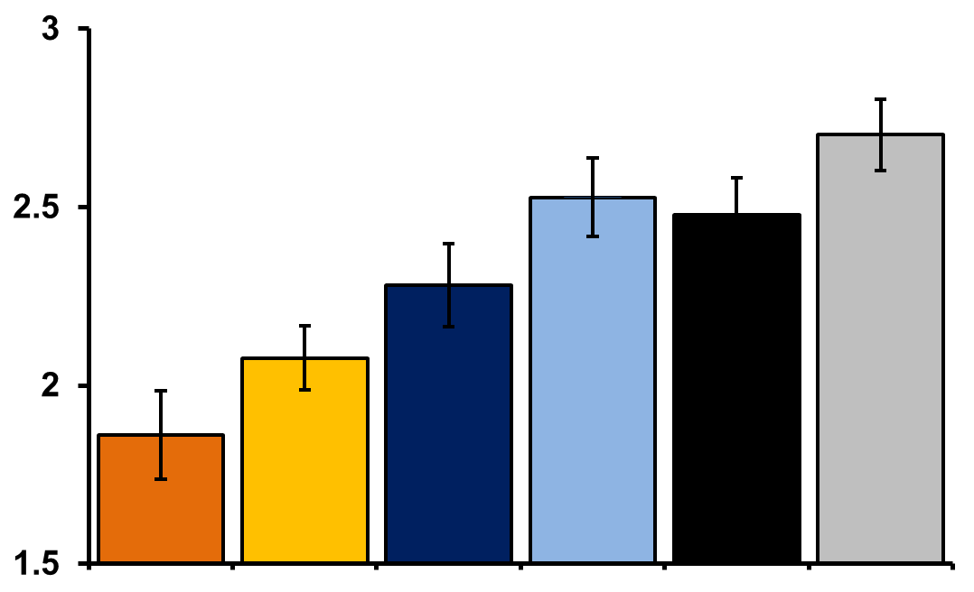
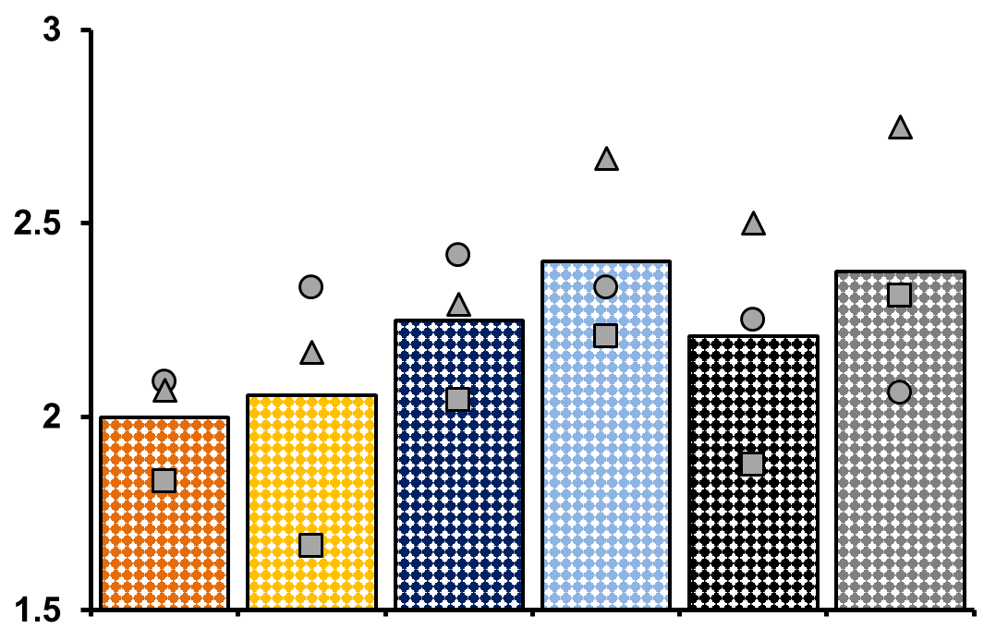
VMPFC: Time
24 per group, matched for gender and education
Matched Healthy Adults vmPFC Patients

Slide 63

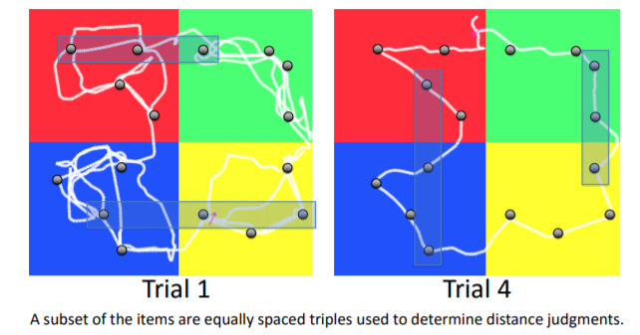
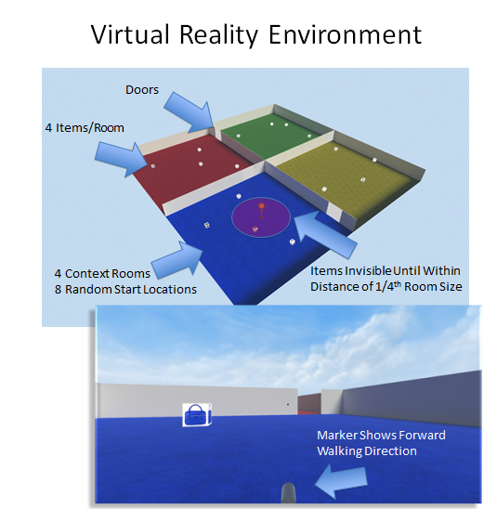
Current and Future Directions
Do context boundaries impact real time spatial navigation strategies and spatial learning in a virtual environment?
(images/data from Horecka et al., 2016 SFN Poster)
Notes:
This is particularly evident for very close information, suggesting these effects may particularly serve to add additional acuity in memory

Slide 64
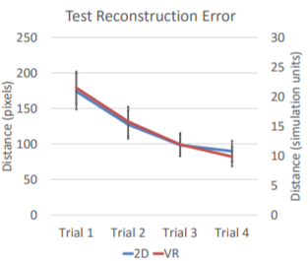
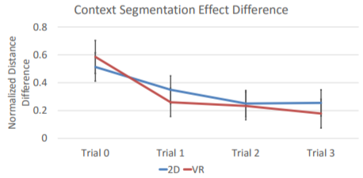
Current and Future Directions
Do context boundaries impact real time spatial navigation strategies and spatial learning in a virtual environment?
(images/data from Horecka et al., 2016 SFN Poster)
Notes:
This is particularly evident for very close information, suggesting these effects may particularly serve to add additional acuity in memory

